Slide 1

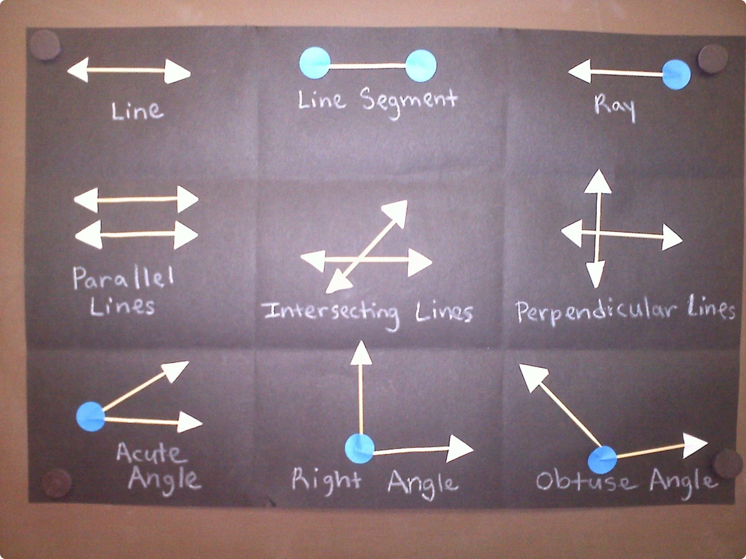
Introduction to Lines and Rays
Welcome to our journey into the fascinating world of geometry! Today, we'll explore the fundamental building blocks of all shapes and figures: points, line segments, lines, and rays. Understanding these basic concepts is crucial for mastering more complex geometric ideas. We will delve into each definition, learn how to represent them, and discover how they apply to the world around us.

Slide 2
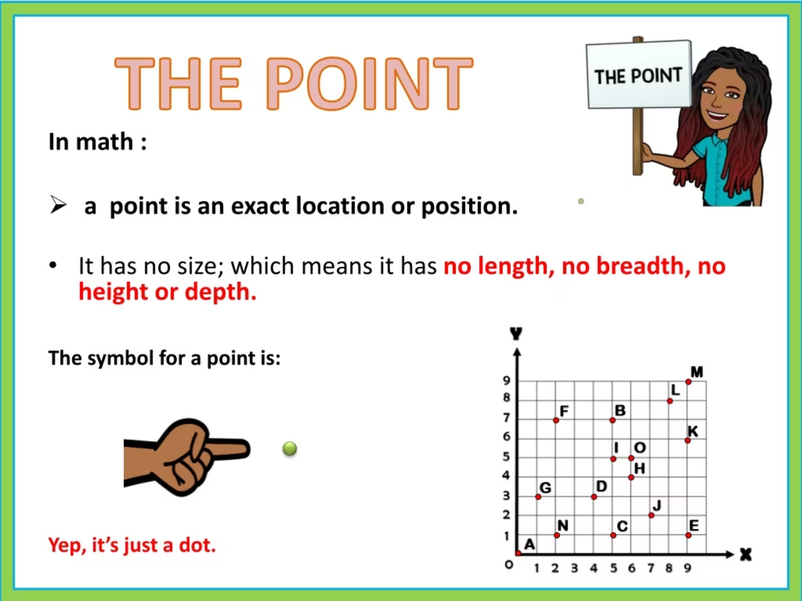
What is a Point?
A point is the most basic element in geometry. It defines a specific location in space and has no dimension, meaning it has no length, width, or height. Think of it as a tiny, precise mark that indicates a position.
We represent a point with a simple dot and name it using a capital letter, such as Point A or Point B. Points are the starting block for constructing all other geometric figures, acting as precise markers in our spatial understanding.
Point A

Slide 3
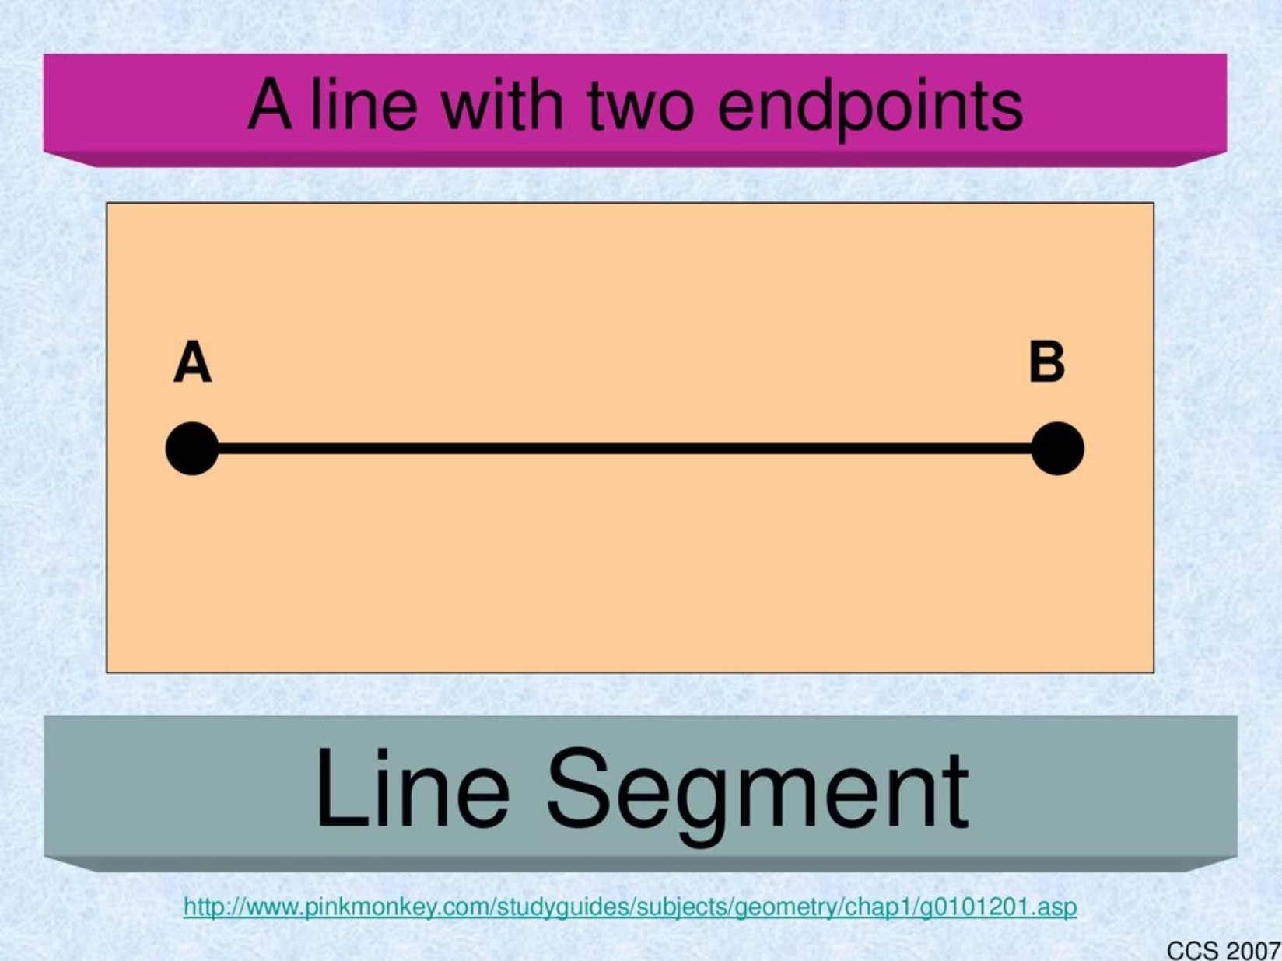
What is a Line Segment?
A line segment is a part of a line that is defined by two distinct endpoints. Unlike a full line, it has a finite, measurable length. Imagine drawing a straight path between two dots; that's a line segment.
We represent a line segment as a straight path with a clear beginning and end. It is named by its two endpoints. For example, a segment with endpoints A and B can be called AB or BA. This fixed length makes line segments vital for measuring distances and constructing precise shapes.
Line Segment AB

Slide 4
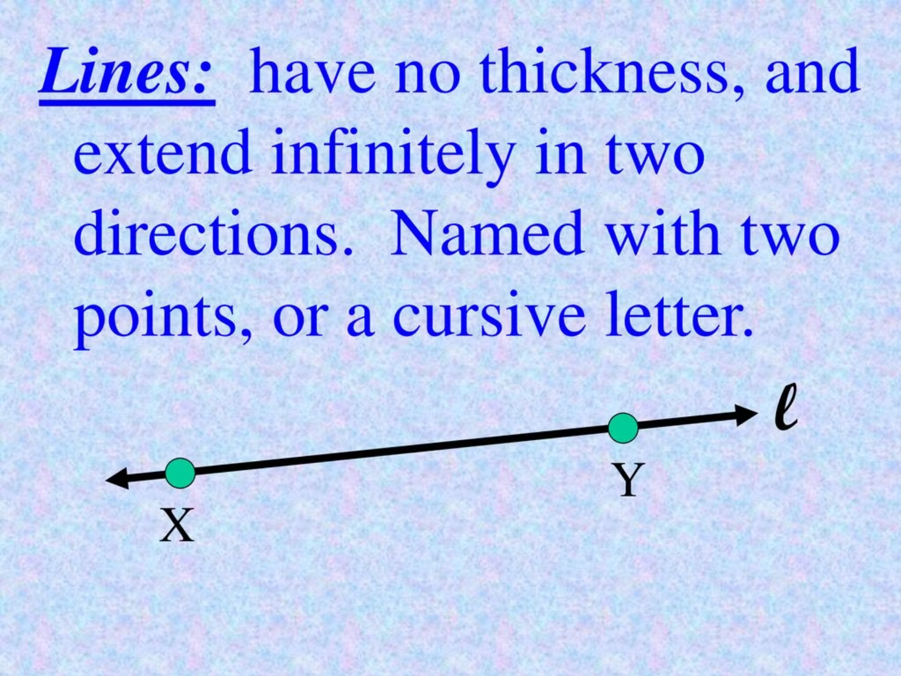
What is a Line?
A line is a straight path that extends infinitely in both directions, meaning it never ends. Unlike a line segment, it has no endpoints and continues endlessly. It represents a continuous sequence of points.
We represent a line with a straight path that has arrows on both ends, indicating its infinite extension. Lines can be named by using two points that lie on the line (e.g., CD or DC) or by a single lowercase letter, such as line 'l'. Lines are fundamental to understanding concepts like parallelism and perpendicularity.
Line XY

Slide 5
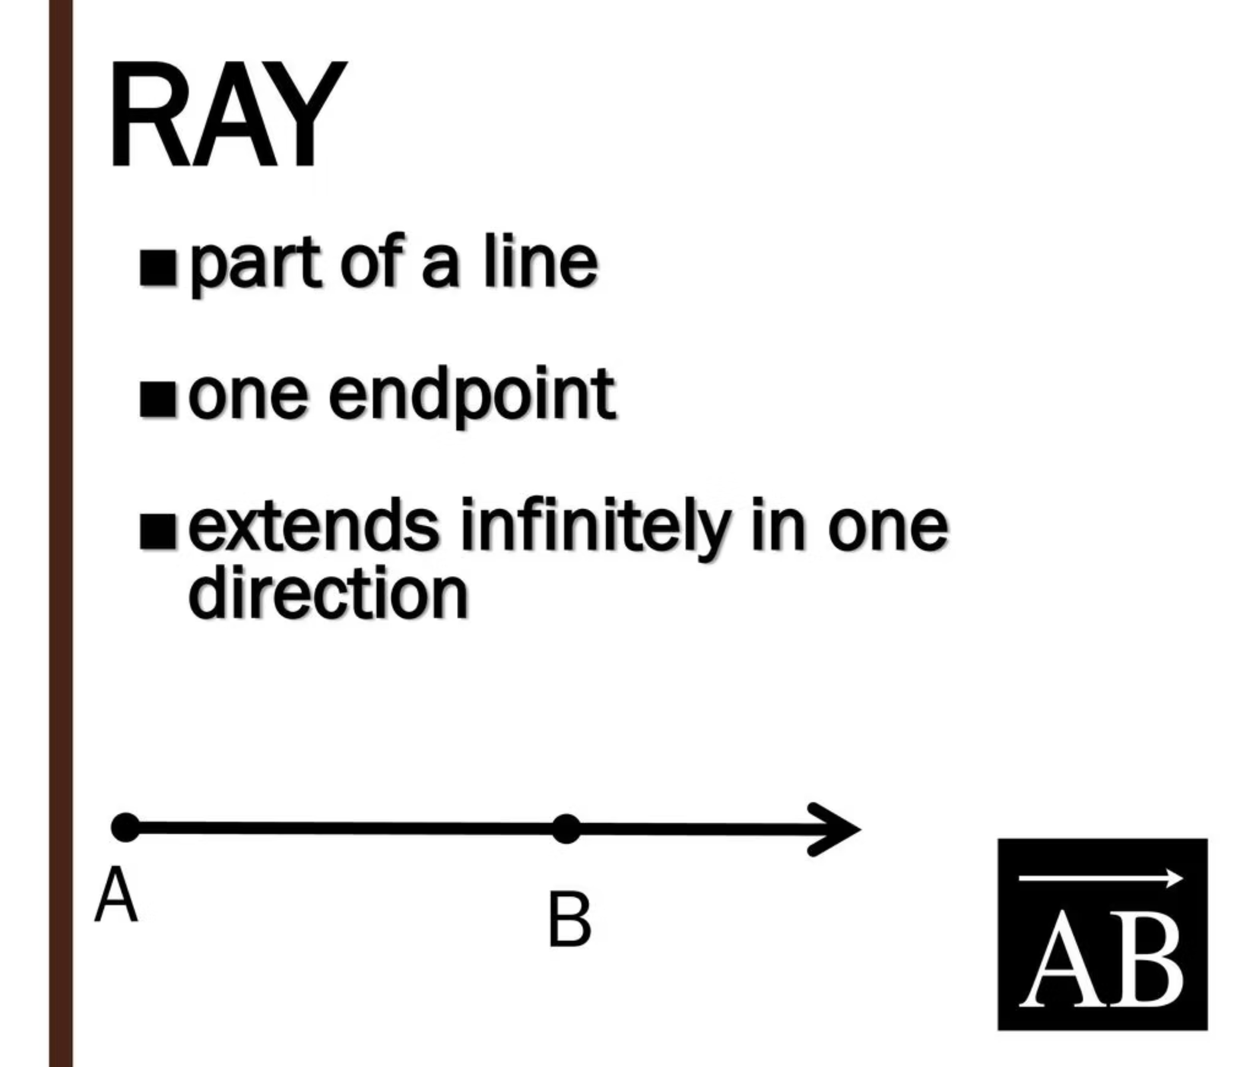
What is a Ray?
A ray is a part of a line that has one endpoint and extends infinitely in only one direction. Think of it as a beam of light emitted from a source. It has a definite starting point but no ending point.
We represent a ray as a straight path starting at a dot (the endpoint) and ending with an arrow, indicating its infinite extension in that direction. To name a ray, we always start with its endpoint, followed by another point on the ray. For instance, a ray starting at E and passing through F is named EF.
Ray EF

Slide 6
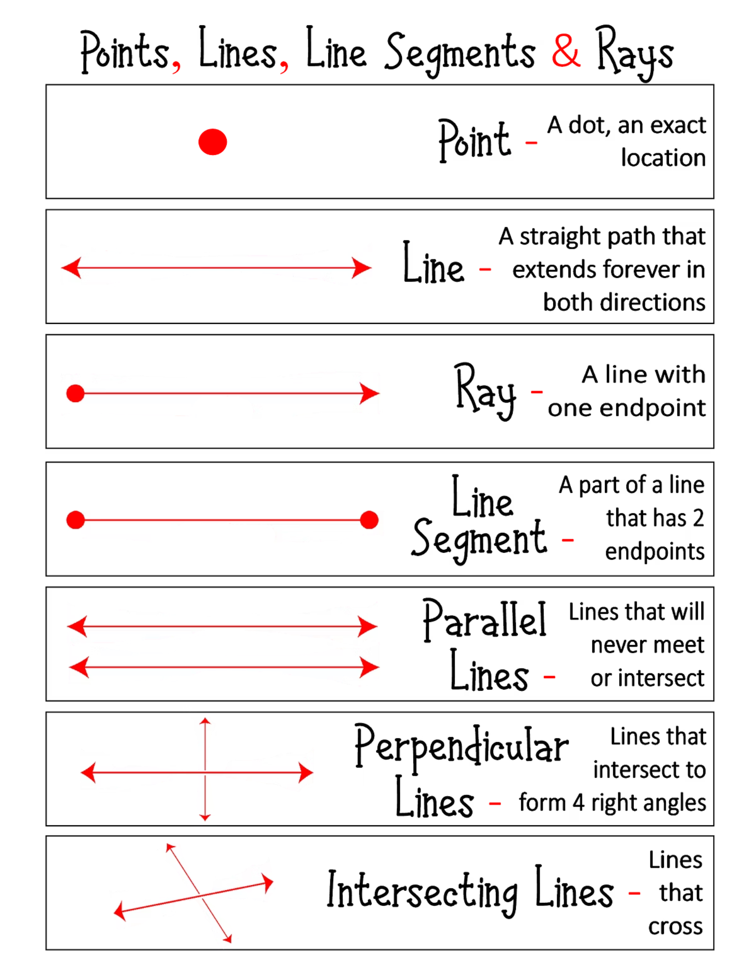
Comparing Lines, Segments, and Rays
Point
A specific location with no dimension or size. Represented by a dot.
Line Segment
A part of a line with two distinct endpoints. It has a measurable, finite length.
Ray
A part of a line with one endpoint, extending infinitely in one direction.
Line
A straight path that extends infinitely in both directions, having no endpoints.
Understanding the distinct properties of points, line segments, rays, and lines is crucial for accurately describing and analyzing geometric figures. Each has a unique role in constructing and comprehending spatial relationships.

Slide 7

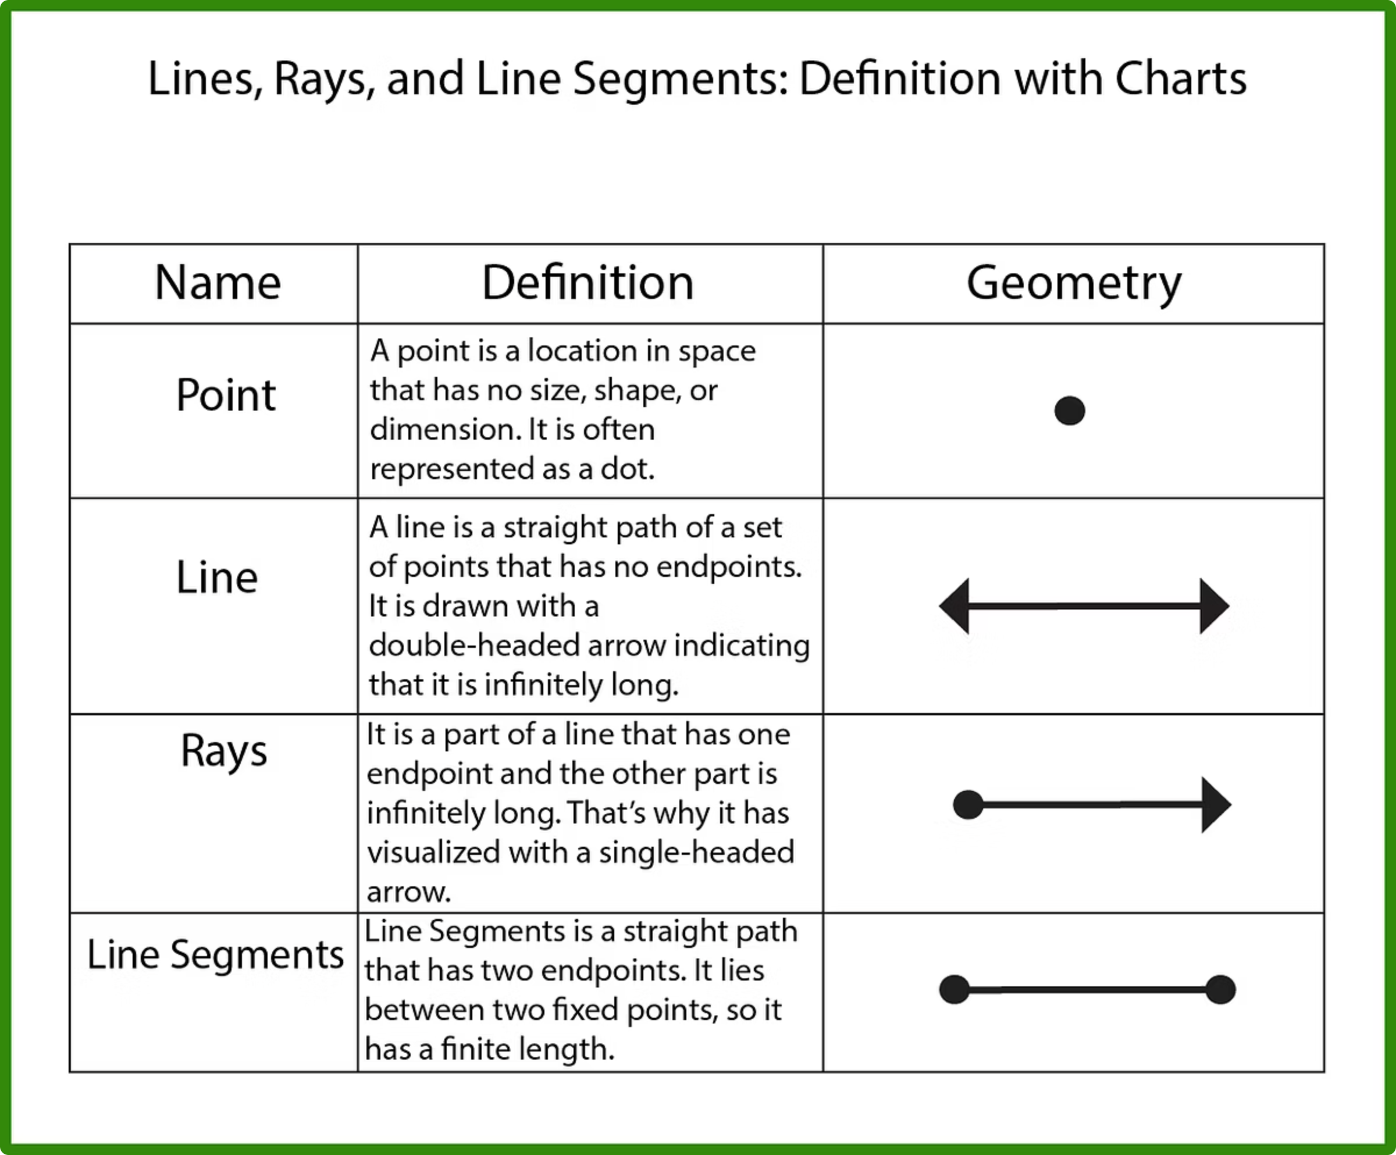
Naming Conventions and Symbols
Point A: A
A single capital letter indicates a specific point.
Line Segment AB: \overline{AB} or \overline{BA}
A line over two capital letters denotes a segment with those endpoints.
Line CD: \overleftrightarrow{CD} or \overleftrightarrow{DC} (or line 'l')
A double-headed arrow over two capital letters, or a single lowercase letter, represents an infinite line.
Ray EF: \overrightarrow{EF} (endpoint first)
An arrow over two capital letters, with the endpoint listed first, indicates a ray.
Using correct notation is essential for clear communication in mathematics. These symbols precisely define the type and orientation of each geometric figure.

Slide 8
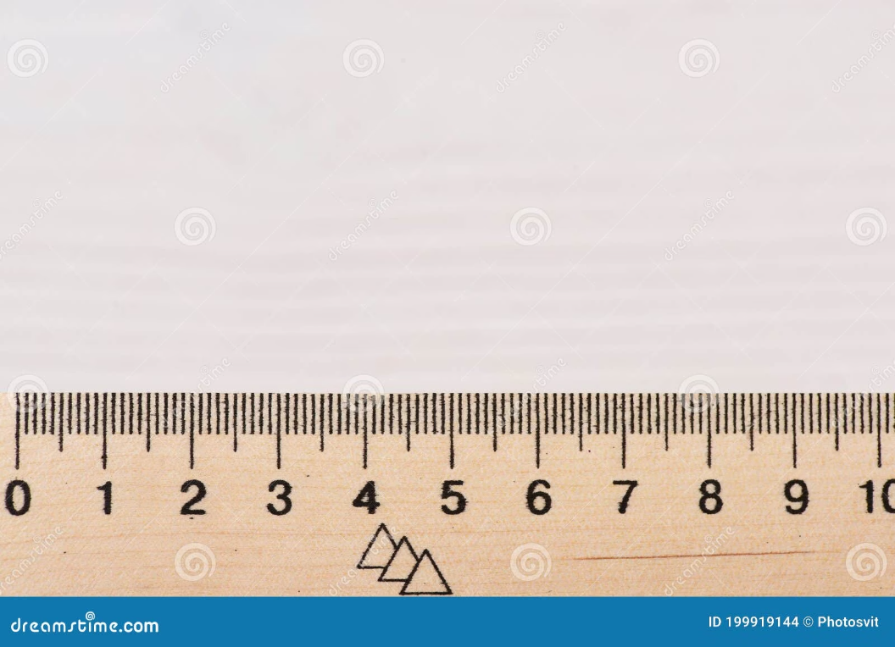
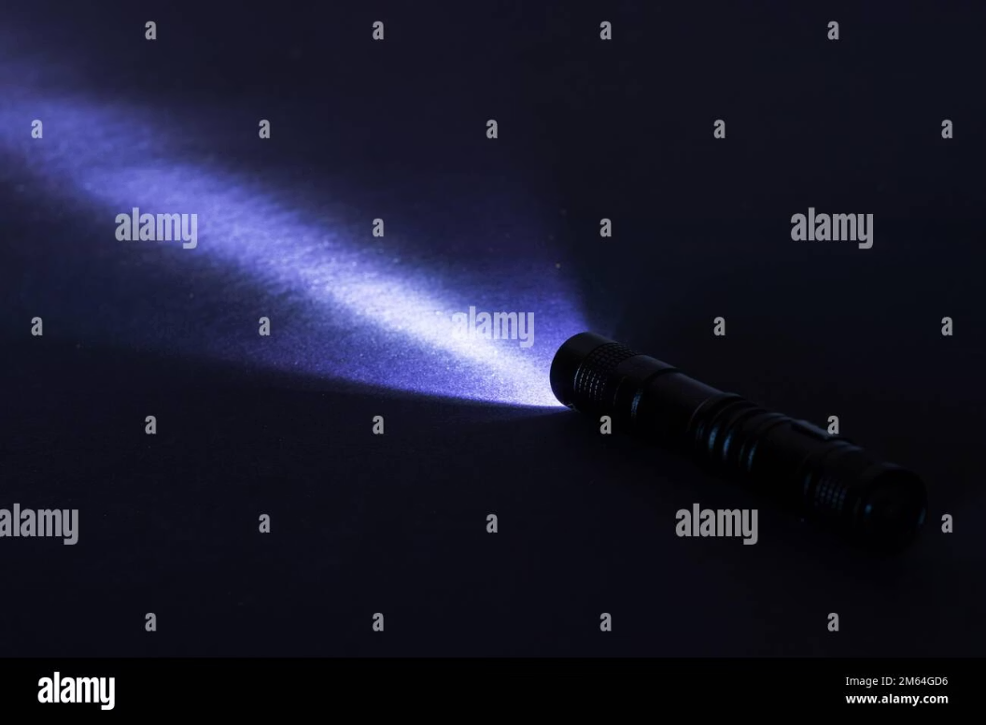

Real-World Examples
Line (Conceptual)
Line Segment
Ray
While a perfect line doesn't exist physically in our limited world, the concept of a horizon line or an idealized laser beam traveling infinitely can help visualize a line. These represent paths with no beginning or end.
The straight edge of a ruler, the side of a book, or a pencil all represent line segments. They have clear starting and ending points and a finite length that can be measured.
A flashlight beam, the sun's rays reaching Earth, or a single beam from a lighthouse are all excellent examples of rays. They originate from a specific point and extend infinitely in one direction.

Slide 9
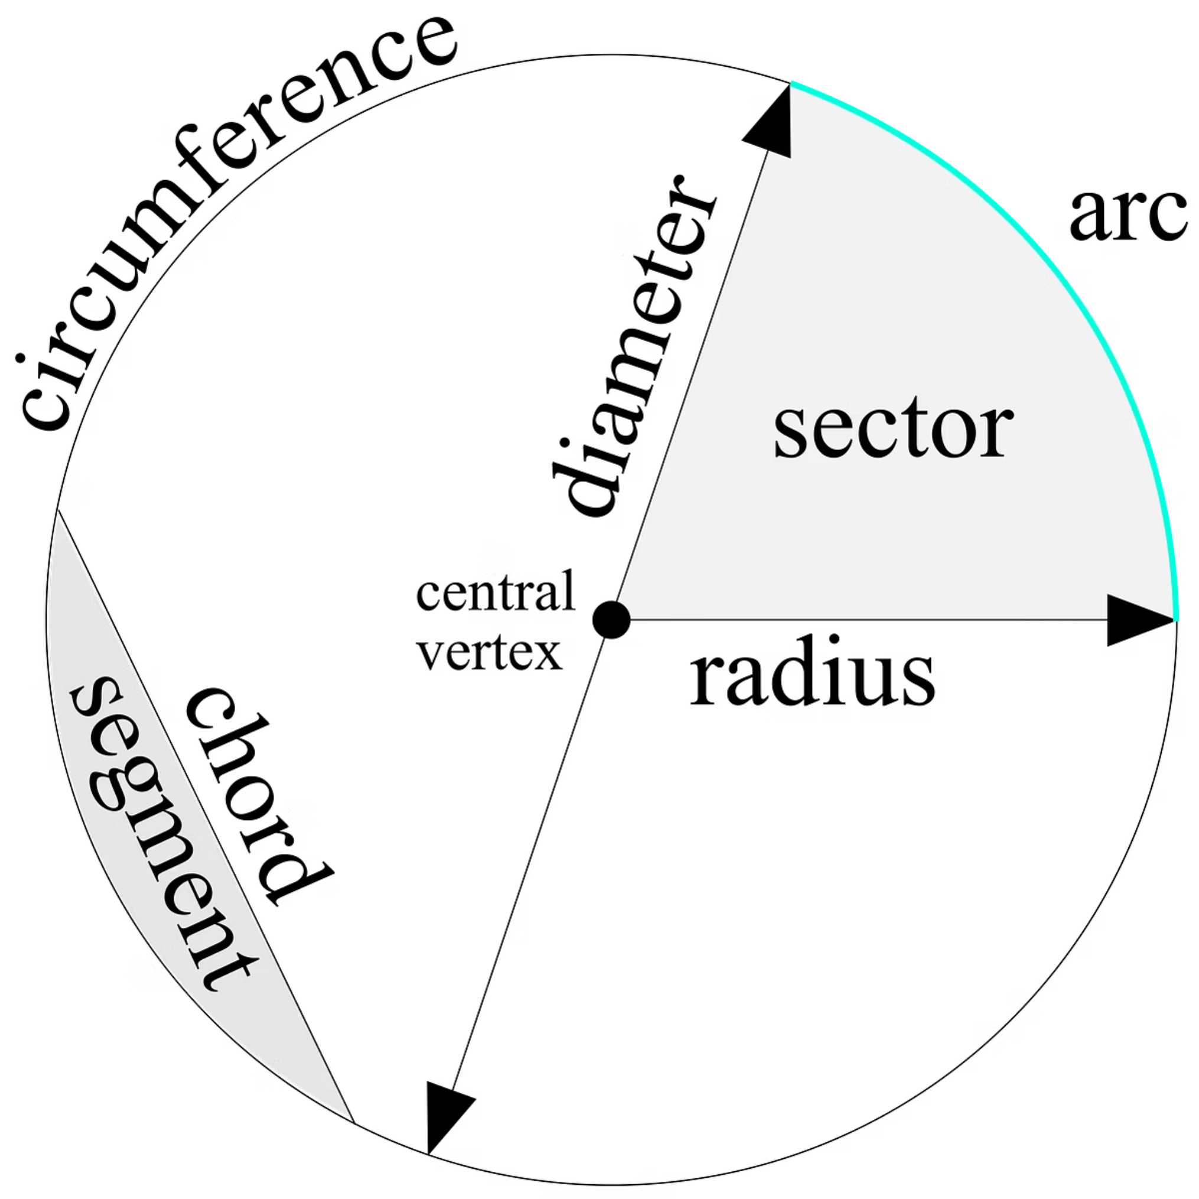
Let's Practice! Identify and Name
Now, let's put your knowledge to the test! Look at the following diagrams and identify whether each one is a line, a line segment, or a ray. Then, try to name each figure using the correct notation we just learned. This exercise will solidify your understanding of these fundamental geometric concepts.
How many endpoints does a ray have?
Think back to our definition. A ray has one definite starting point and extends indefinitely in one direction. So, the answer is 1 endpoint.
Consider a circle:
A radius is a line segment from the center of a circle to any point on its circumference. A diameter is a line segment that passes through the center of the circle and has both endpoints on the circumference.

Slide 10

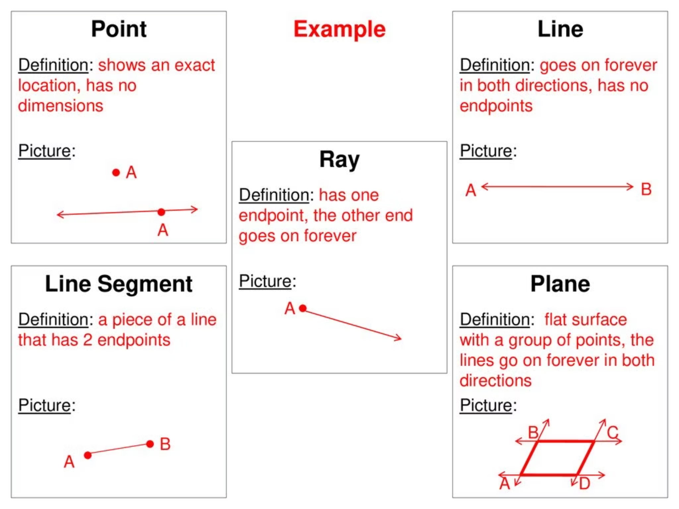
Summary: Key Takeaways
Points as Basic Locations
Points are the foundational elements, marking specific positions without dimension.
Line Segments: Defined Ends
Line segments have two clear endpoints and a measurable length, making them finite.
Rays: One End, Infinite Reach
Rays start at one point and extend endlessly in a single direction.
Lines: Infinite in Both Ways
Lines have no endpoints, continuing infinitely in both directions.
Mastering these core geometric terms—points, line segments, rays, and lines—is essential. They are the building blocks that allow us to understand and construct more complex shapes and figures in geometry, forming the basis for all spatial reasoning.

Slide 11
Thank You!
We appreciate you joining this session on fundamental geometric concepts.
Mastering points, lines, segments, and rays builds a strong foundation.

